Slide 1
Context Prior for Scene Segmentation
Changqian Yu^{1,2} Jingbo Wang³ Changxin Gao^{1∗} Gang Yu⁴ Chunhua Shen² Nong Sang
¹Key Laboratory of Image Processing and Intelligent Control, School of Artificial Intelligence and Automation, Huazhong University of Science and Technology ²The University of Adelaide, Australia ³The Chinese University of Hong Kong ⁴Tencent
CVPR 2020
Speaker: Cong Fang

Slide 2
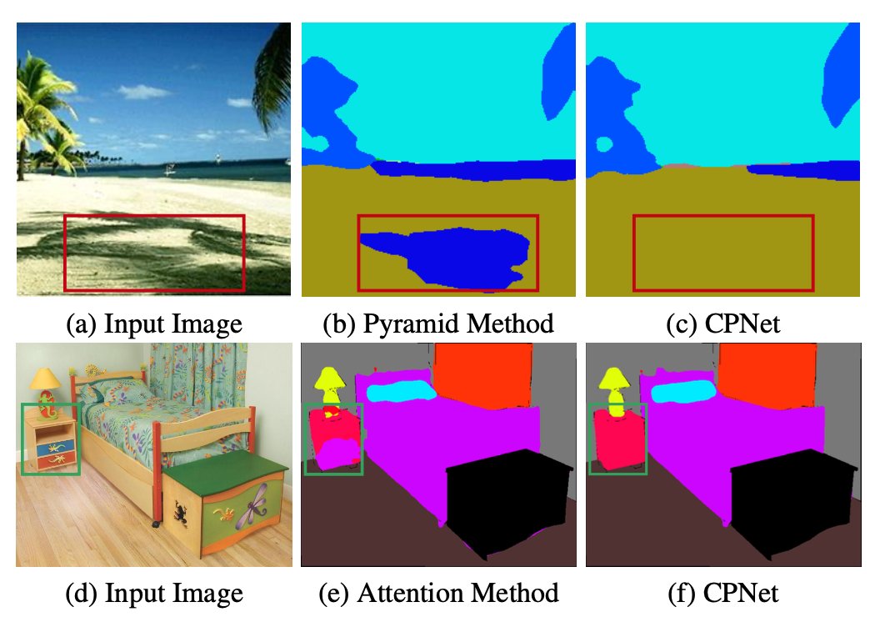
Motivation
Most approaches rarely distinguish different types of contextual dependencies
Attention\Non-local\pyramid pooling

Slide 3
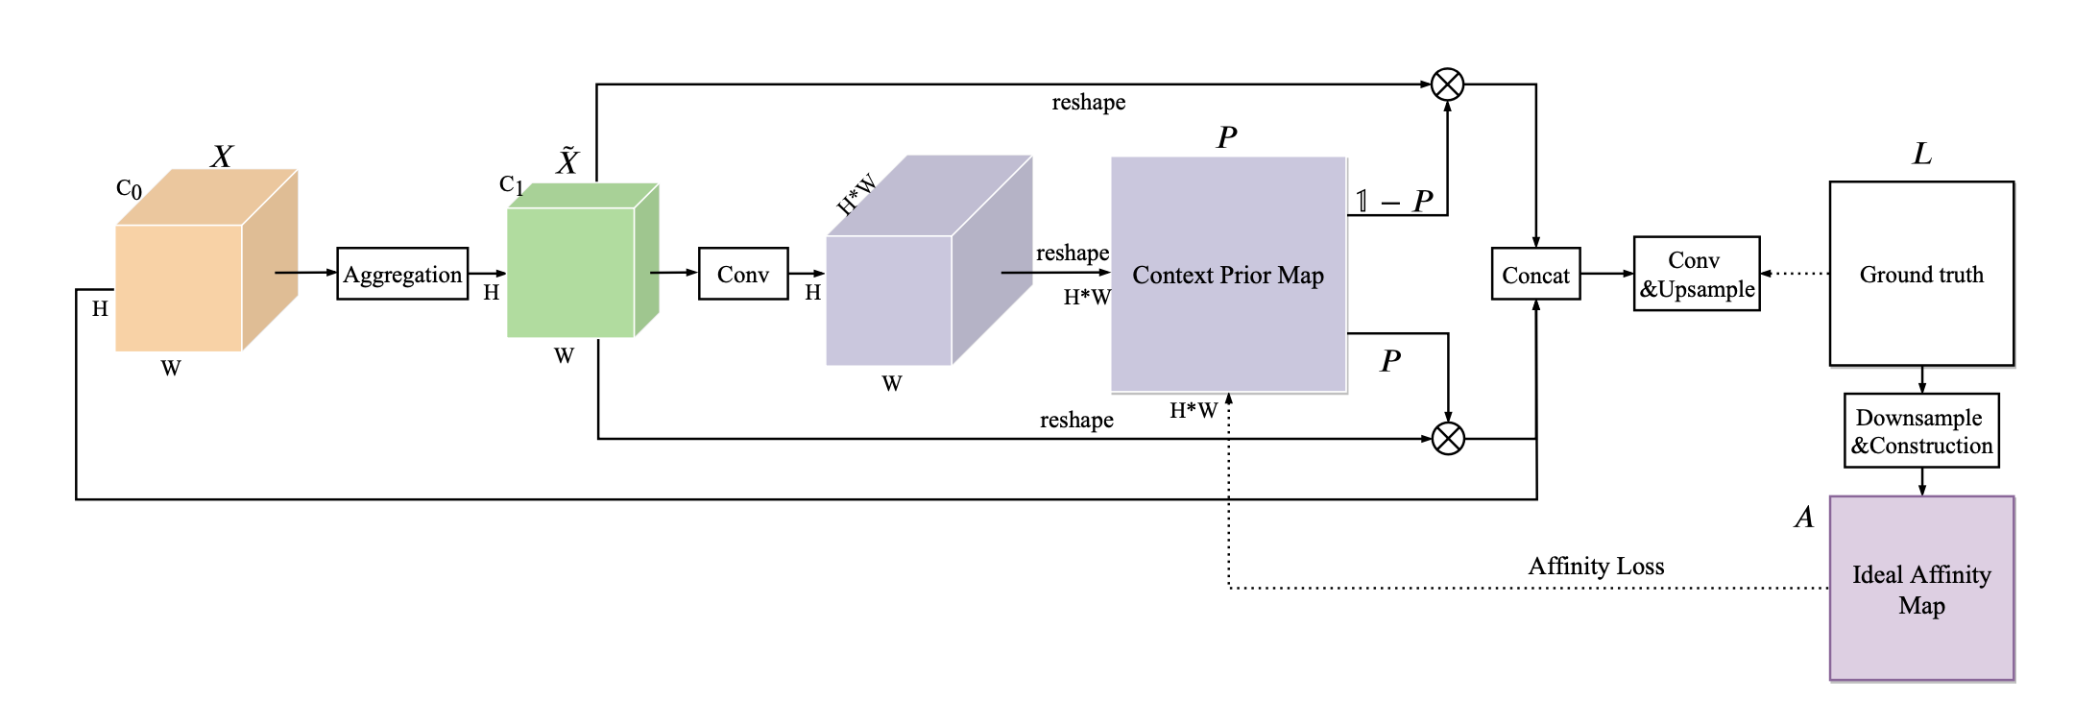
Contributions
Construct a Context Prior to model the intra-class and inter-class dependencies as the prior knowledge.
Develop a Context Prior Layer incorporating an Affinity Loss, which directly supervises the learning of the prior.
Aggregation Module which adopts the fully separable convolution to efficiently aggregate spatial information.

Slide 4
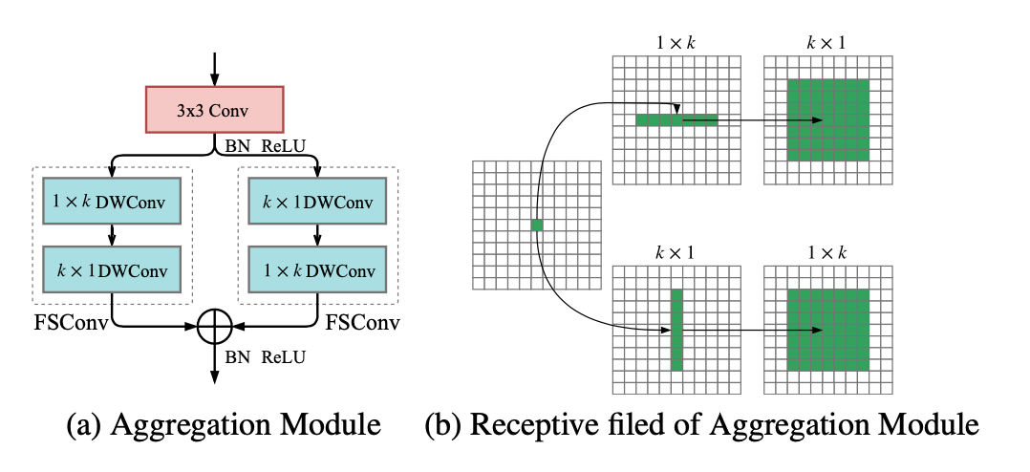
Method
DWConv depthwise convolution
FSConv fully separable convolution

Slide 5
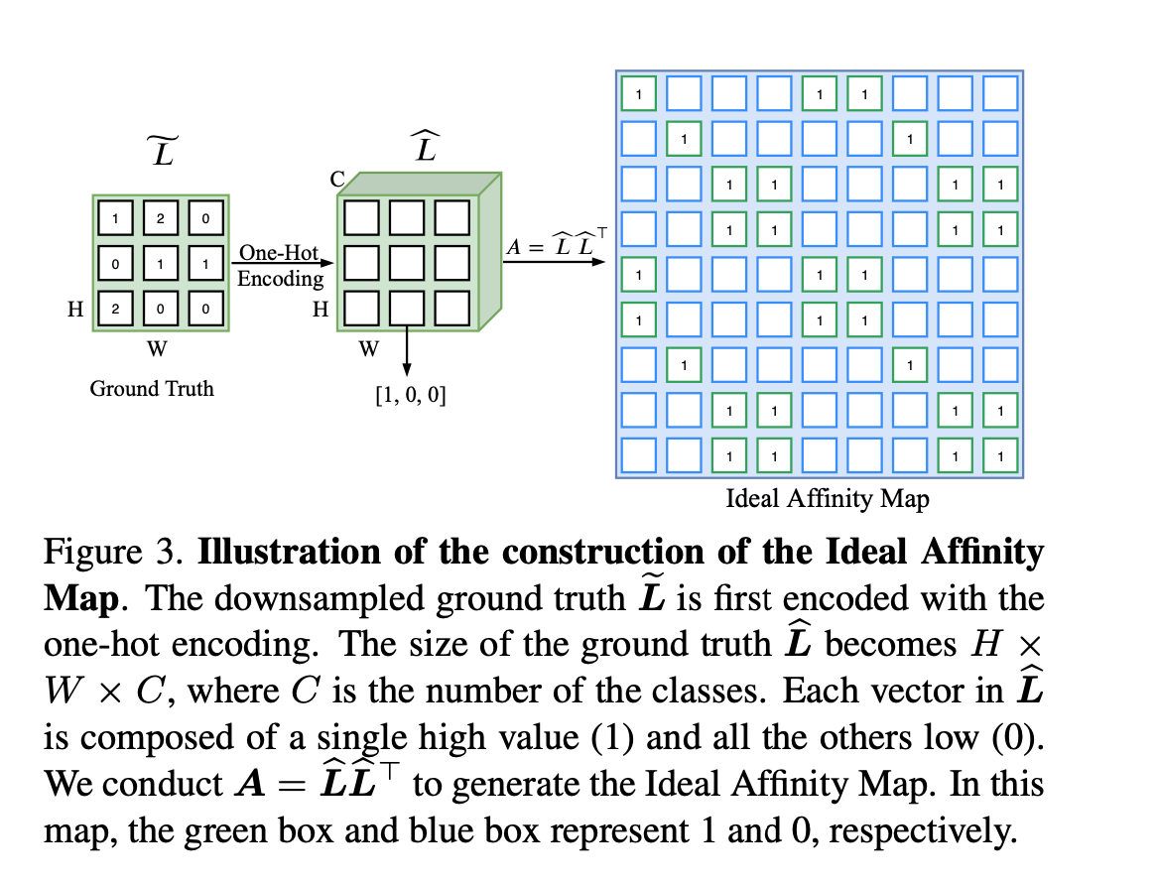
Method
L hat reshape to (N, C) size, where N=H*W

Slide 6
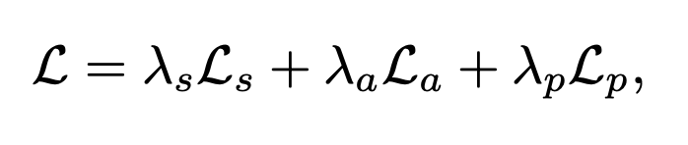
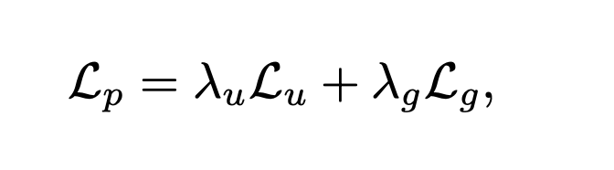
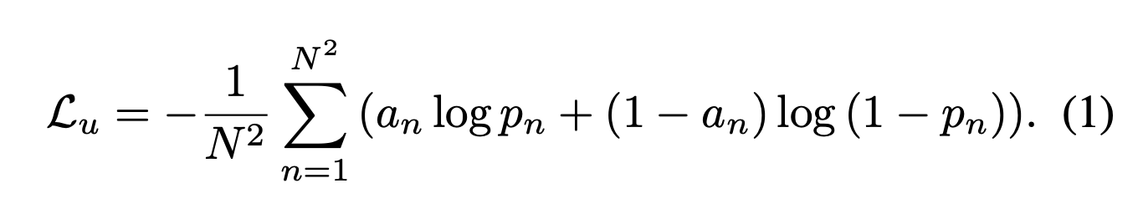
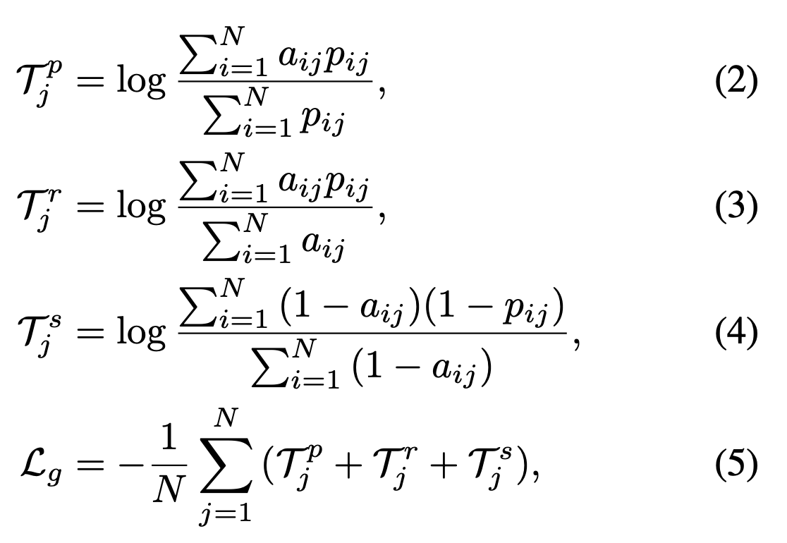
Affinity Loss
The final loss
Affinity Loss
Binary cross entropy loss
precision=TP/(TP+FP)
recall=TP/(TP+FN)
specificity =TN/(TN+FP)

Slide 7
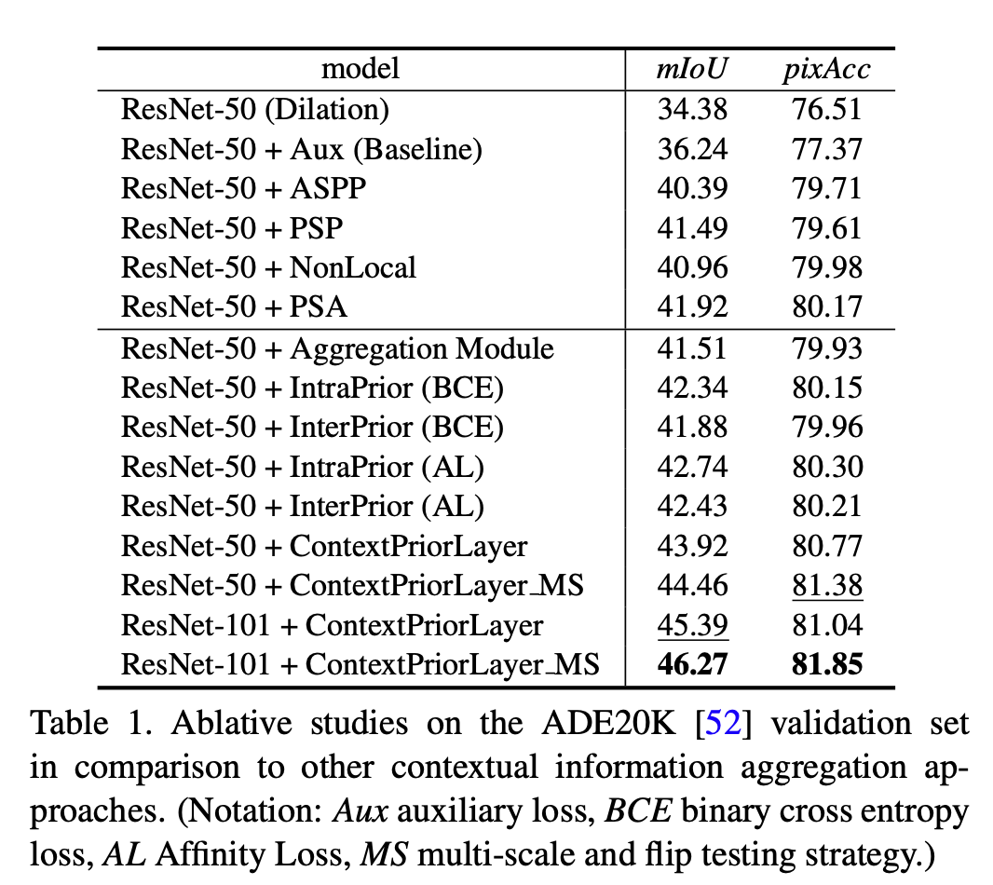
Ablation studies

Slide 8
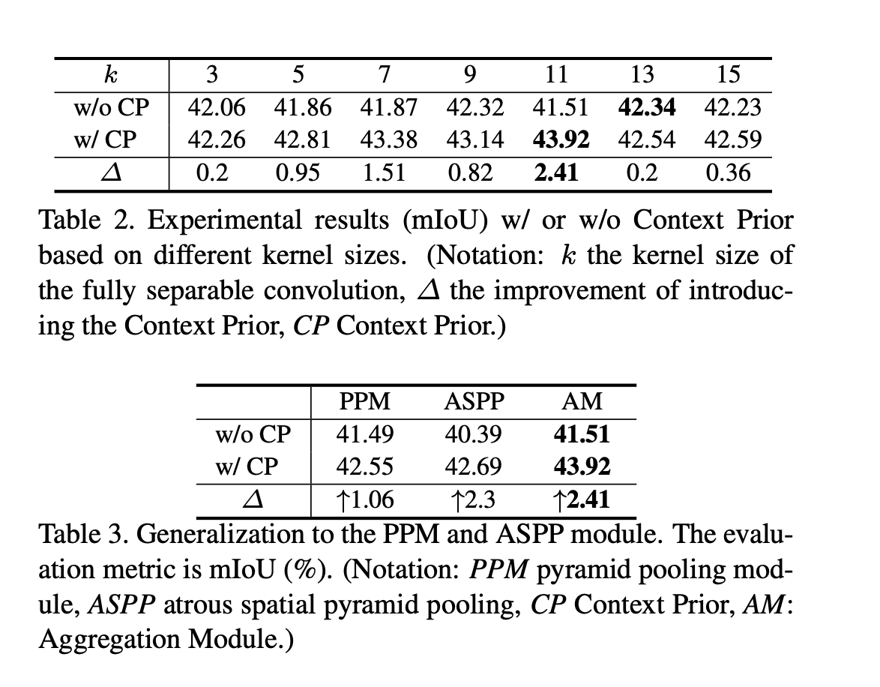
Ablation studies

Slide 9
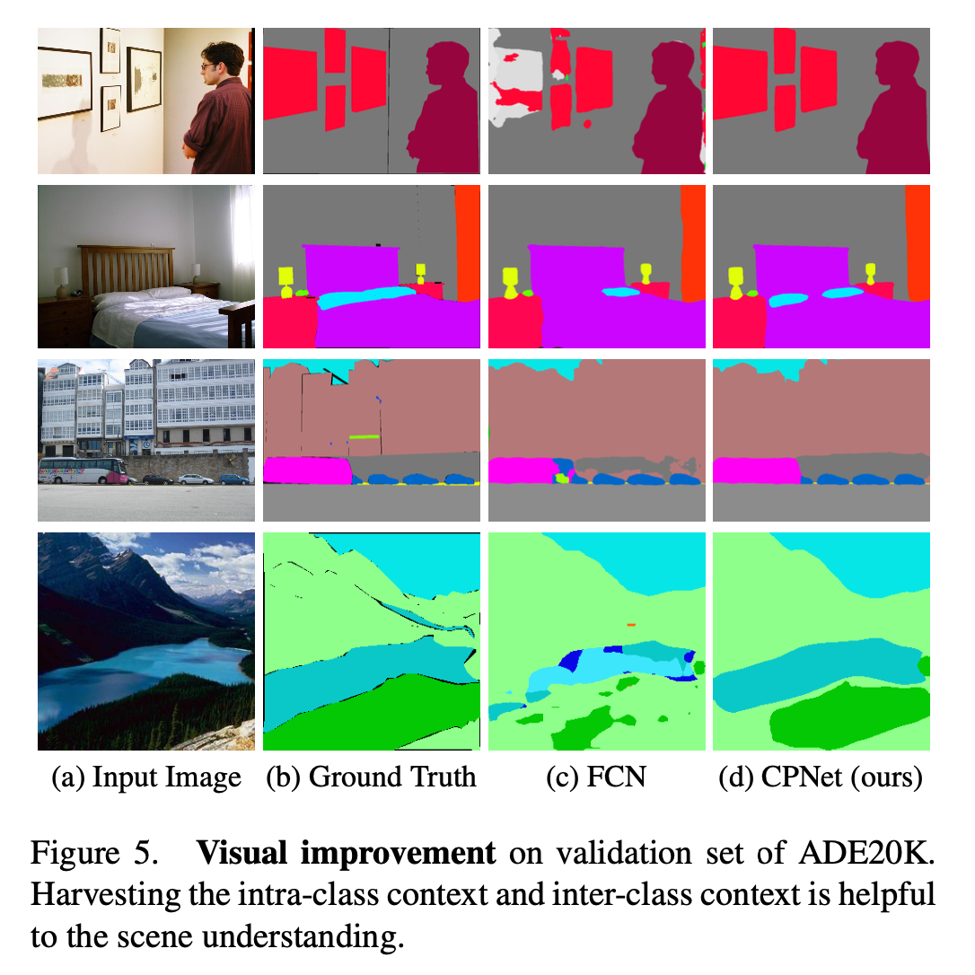
Experiments

Slide 10
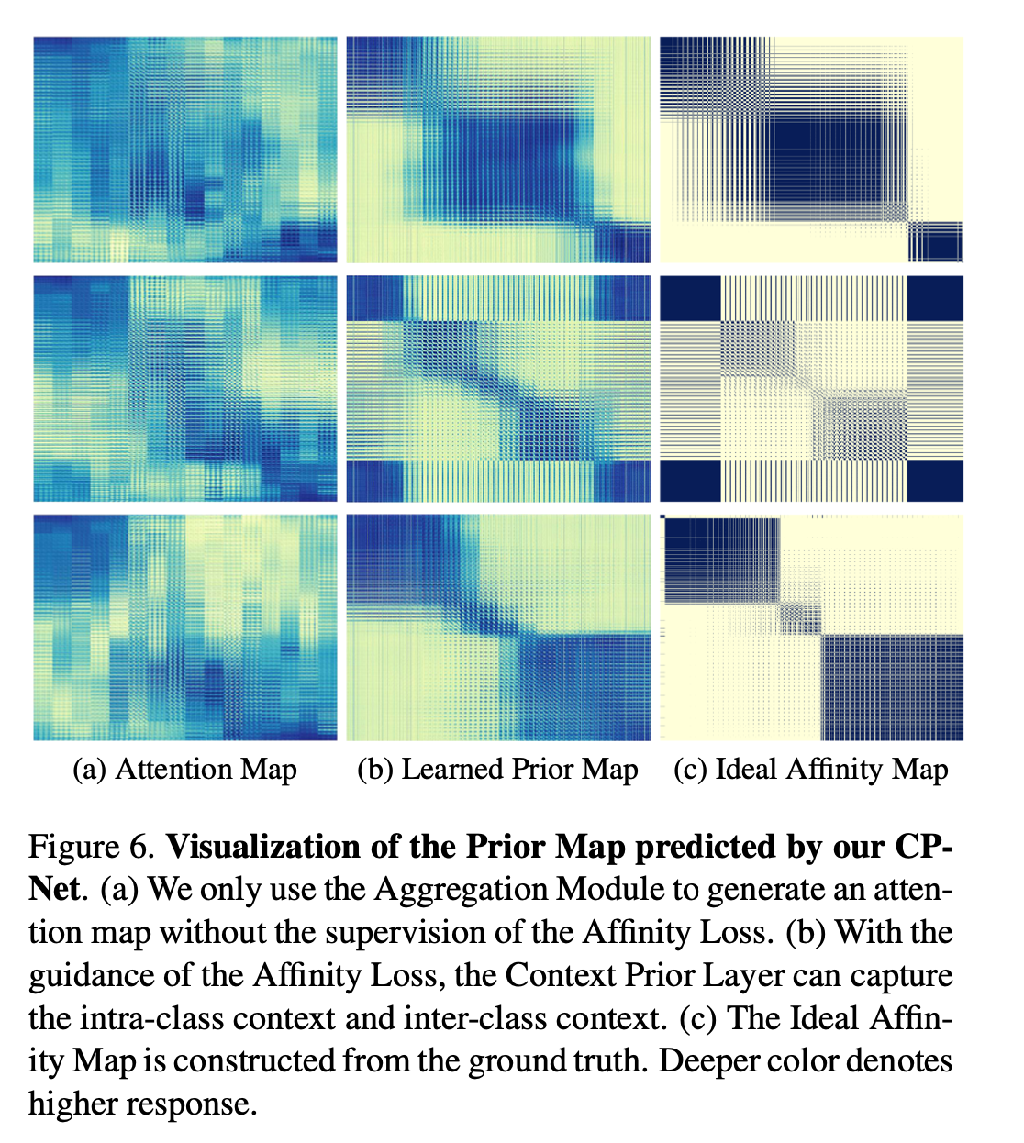
Experiments

Slide 11
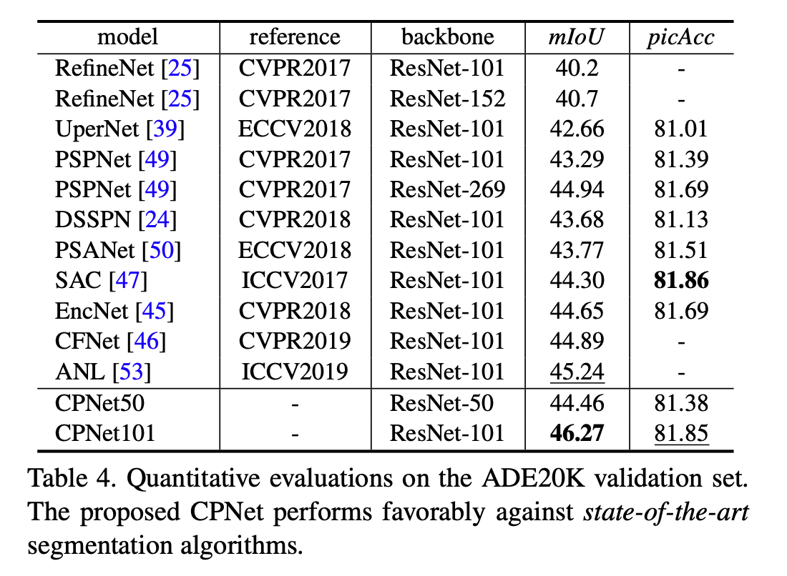
Experiments

Slide 12
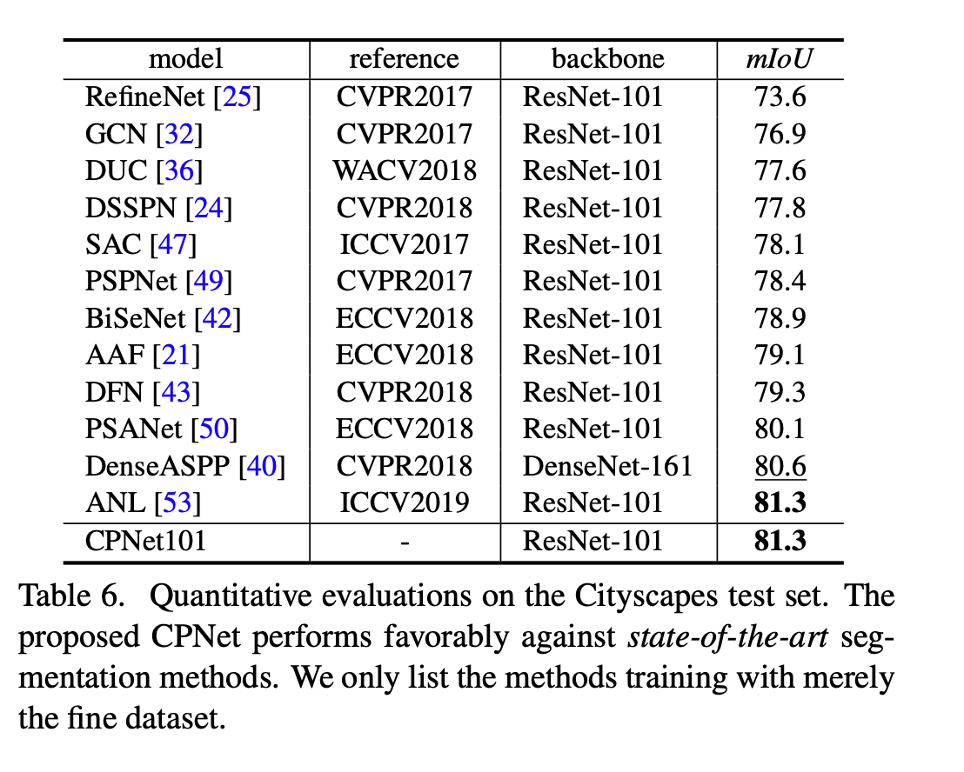
Experiments

Slide 13
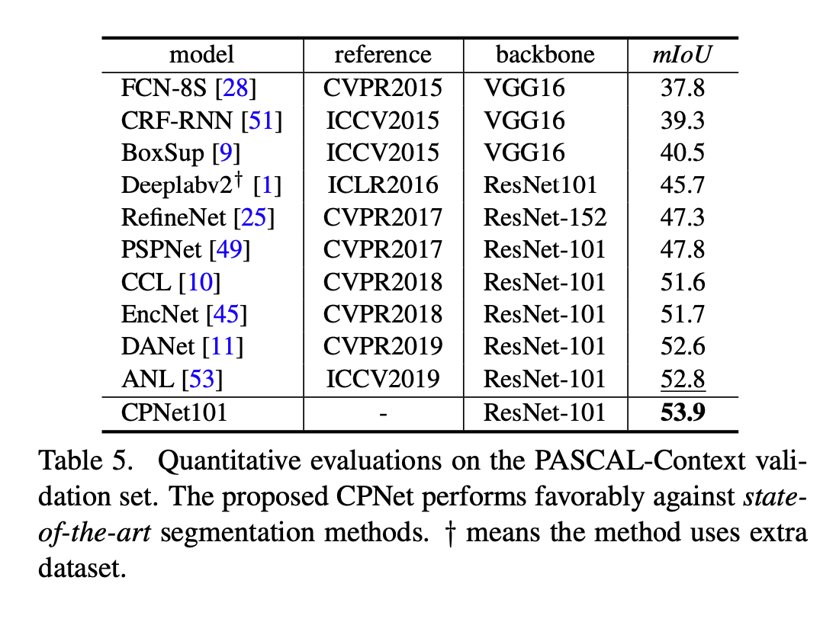
Experiments

